Slide 1
Evidence for intrinsic magnetic scatterers in the topological semimetal (Bi₂)₅(Bi₂Se₃)₇
Notes:
Hello everyone, thanks for the introduction
Today I have the pleasure to present you the recent results that my research group at UCLouvain has obtained in close collaboration with IMEC and the KULeuven.
We investigate magnetotransport in MBE grown superlattice of Bi2Se3 and conclude to the likely existence of intrinsic magnetic scatterers in these heterostructures.

Slide 2
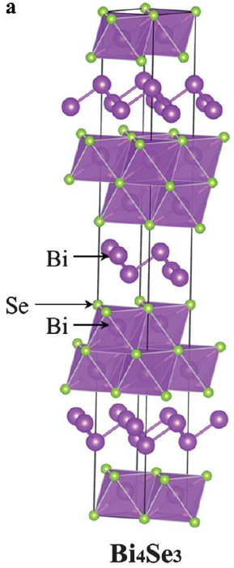
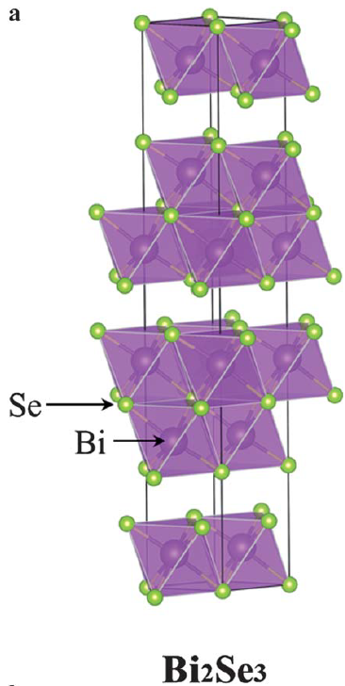
Bi_{x}Se_{y} compounds
3D topological insulator
➔ Insulating bulk with topological surface states
3D topological semimetal
Semimetal bulk with topological surface states
http://www.himikatus.ru/art/phase-diagr1/Bi-Se.php
Phys. Rev. B 88, 081108(R) (2013)
Notes:
If we look at the phase diagram of Bi-Se compounds, among the vast diversity of compounds, two have had recently highlights due to the topological states they hos.
Bi2Se3, in green, is a vastly known topological insulator.
Bi4Se3, in orange, is in turn a topological semimetal which means he has a conducting bulk with topological surface states. As you can see in its lattice structure, it is made of a repetition of Bi2 and Bi2Se3 layers. It also has the particularity to keep these topological states in the monolayer limit oppositely to Bi2Se3.

Slide 3
Motivation
2D topological insulator
Well studied 3D topological insulator
Hosts topological surface states
Unique platform to study inter-layer interactions
Bi₂Se₃ in its trivial phase can be used as a substrate for realising a Bi₂ 2D TI
Hirahara, T. et al. Phys. Rev. Lett. 107 (2011) 166801
Kim, S. H. et al. Phys. Rev. B 89 (2014),155436
Notes:
If we look at the phase diagram of Bi-Se compounds, among the vast diversity of compounds, two have had recently highlights due to the topological states they hos.
Bi2Se3, in green, is a vastly known topological insulator.
Bi4Se3, in orange, is in turn a topological semimetal which means he has a conducting bulk with topological surface states. As you can see in its lattice structure, it is made of a repetition of Bi2 and Bi2Se3 layers. It also has the particularity to keep these topological states in the monolayer limit oppositely to Bi2Se3.

Slide 4
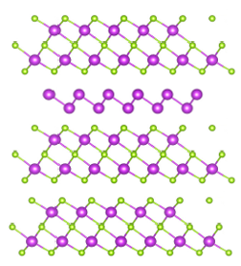
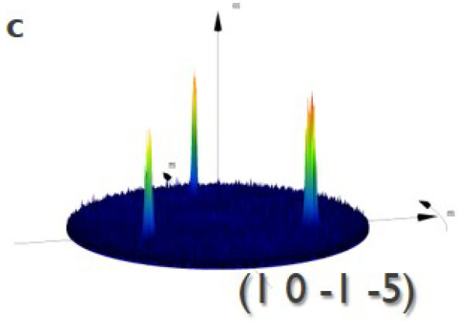
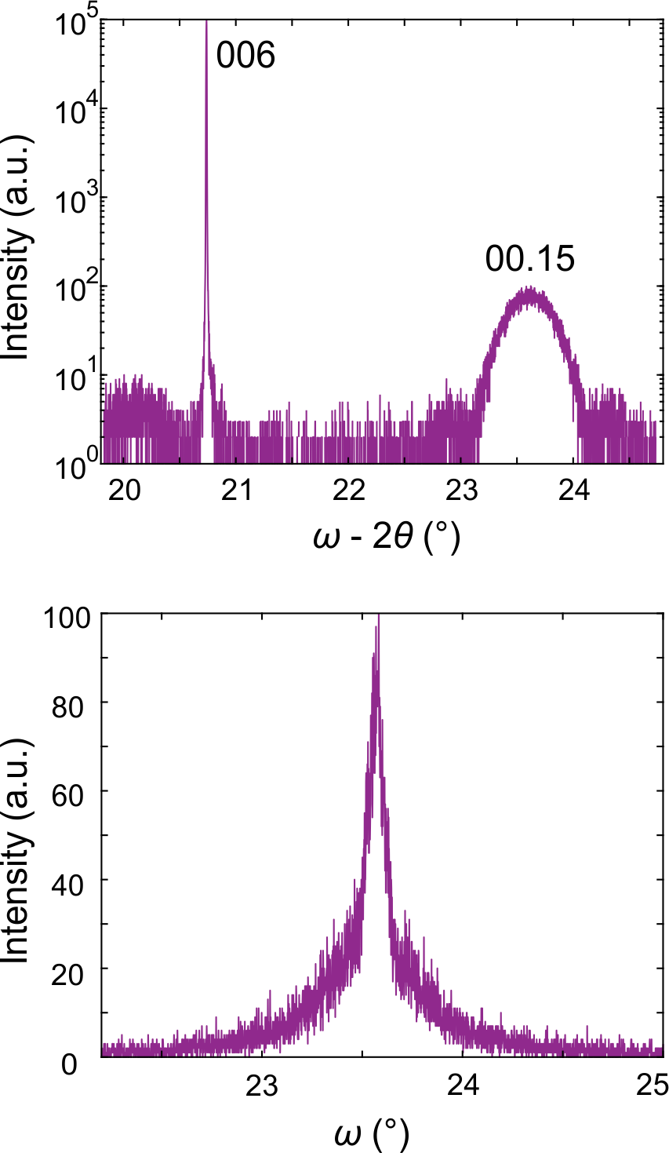
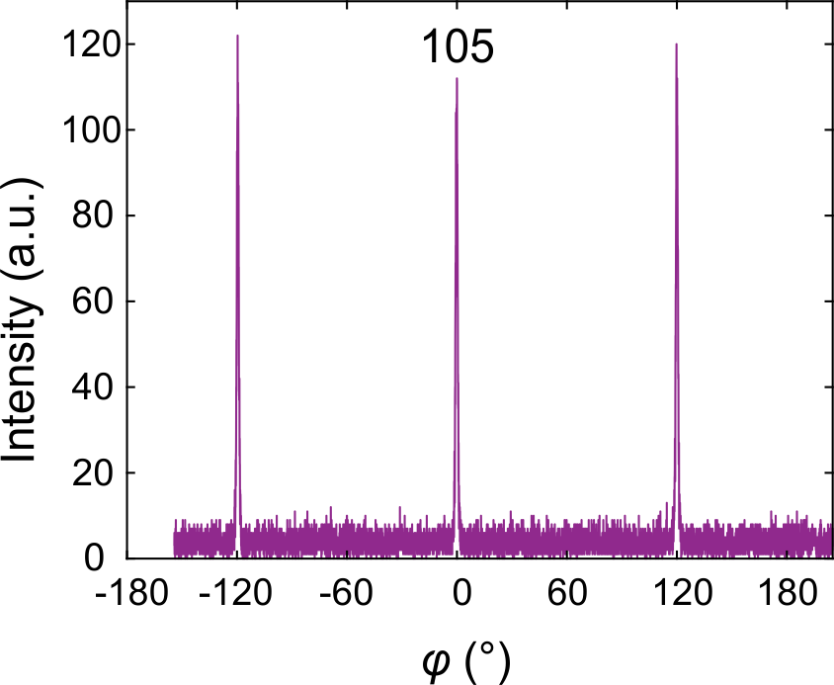
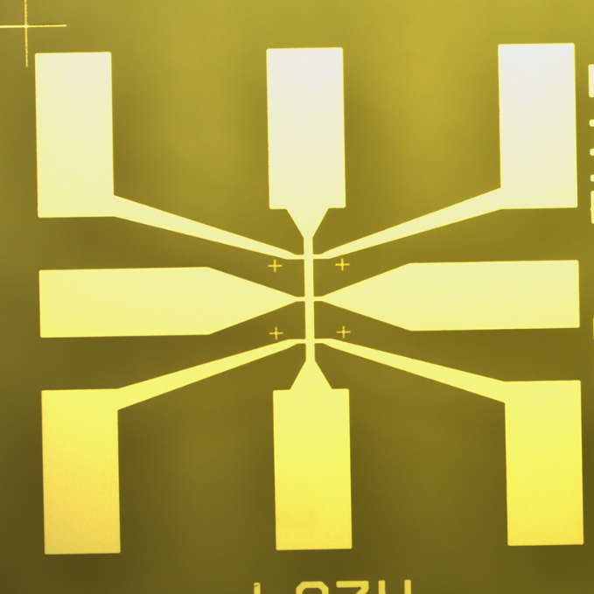
Fabrication process
Plasma-assisted molecular beam epitaxy (PA-MBE)
Introducing excess Bi atoms leads to the creation of Bi2 layers
Hypothesis : Bi excess atoms form nucleation centers which reduce defect concentration
(Bi₂)_{m}(Bi₂Se₃)_{n}
XRD suggests
High crystal quality
No twin formation
FWHM = 0.1119°
Notes:
Starting from Bi4Se3, we can change the periodicity of the Bi2 layers along the out of plane direction to create new heterostructures.
These materials are deposited using plasma-assisted molecular beam epitaxy. The pressure of H2Se can be varied to control which kind of layers is deposited.
It was observed that Bi2 layers reduce overall wrinkling on the deposited films. The associated mechanism could be explained by the formation of nucleation point by the Bi atoms.
You can see at the bottom of the slide the full fabrication process. The material is deposited by MBE and encapsulated in situ. It is then shaped into a Hall bar and contacted.

Slide 5
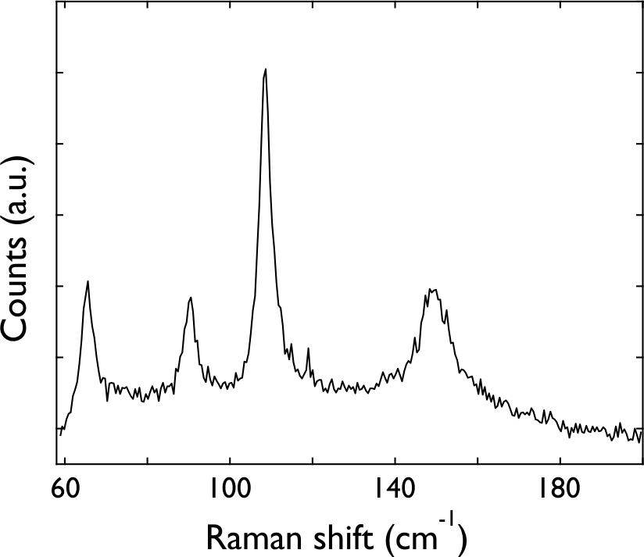
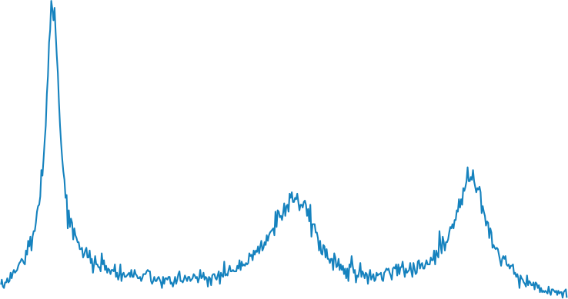
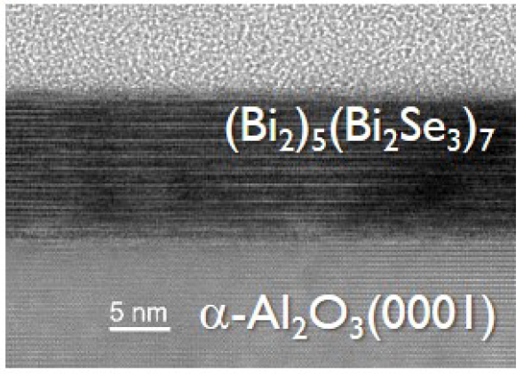
Raman spectrum
Raman spectrum does correspond to simple compounds
➔ Suggests a superlattice
Measured
Bi₂Se₃
Bi₄Se₃ = (Bi₂)(Bi₂Se₃)
BiSe = (Bi₂)(Bi₂Se₃)₂
Notes:
The Raman spectrum obtained on the heterostructure is shown in black.
In blue and purple are the spectra of Bi2Se3 and Bi4Se3 respectively.
The spectrum of a third compound likely to be formed, BiSe is also shown.
Although resembling these spectra, it is clear that the compound that was formed is none of these species.

Slide 6
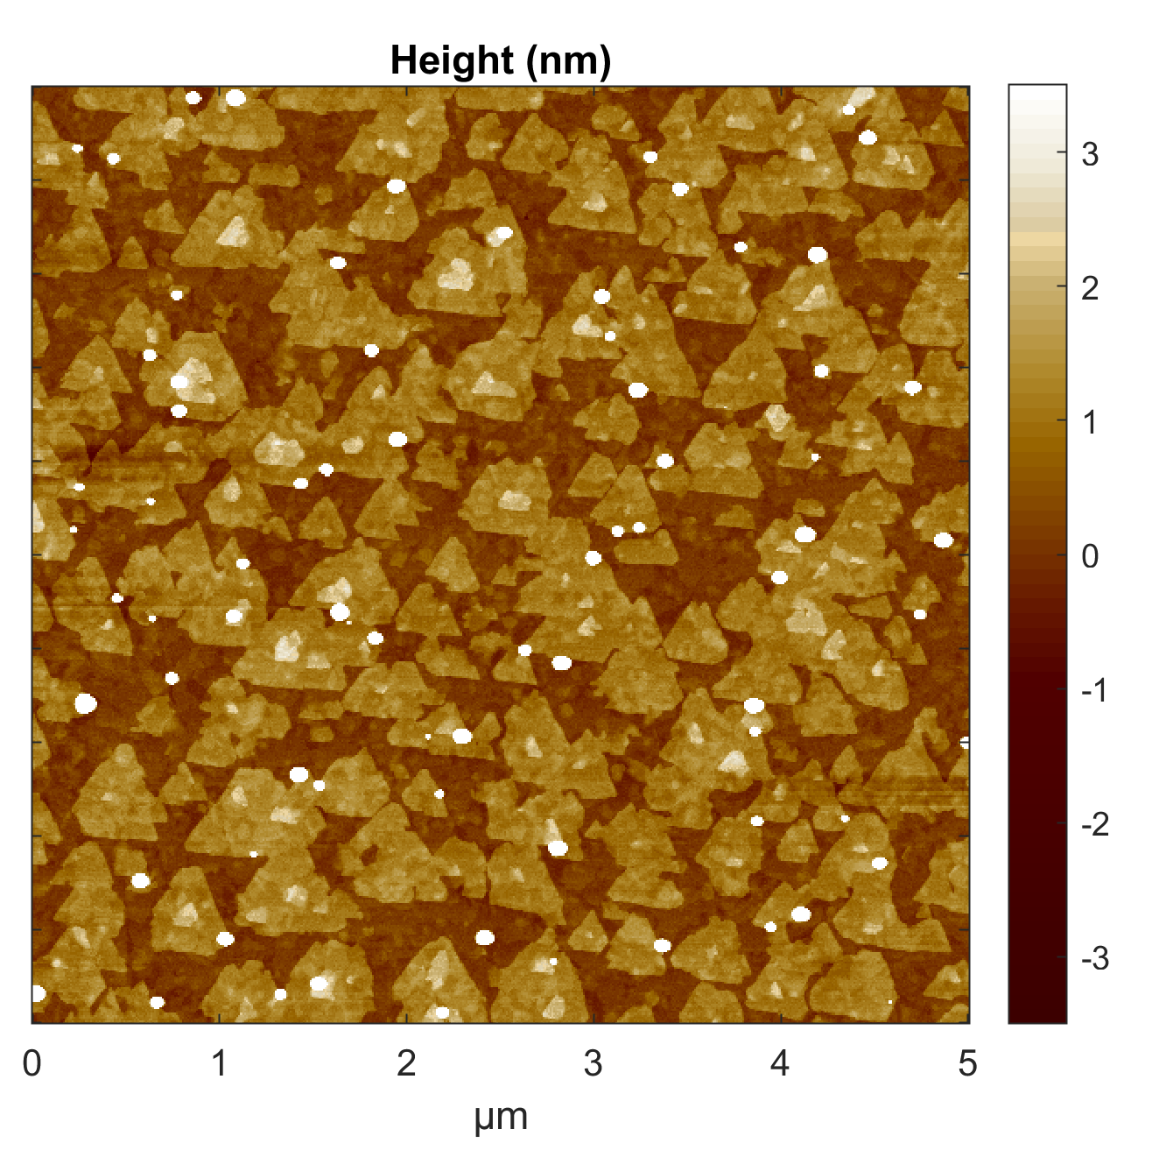
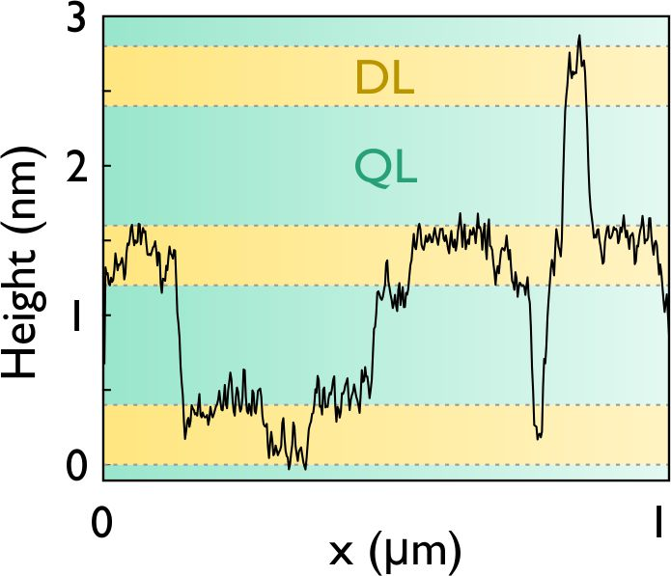
Superlattice
Typical Bi-Se triangular growth pattern
Thickness patterns gives the superlattice periodicity
➔ (Bi₂)₅(Bi₂Se₃)₇
Springholz, G. et al. Phys. Rev. Mater. 2, (2018) 054202
Jia, G., Wang, X., Li, Q. & Yao, J. Superlattices and Microstructures 66, (2014), 33–38
Notes:
The AFM images obtained on the surface give clues to identify the exact heterostructure that was grown.
As you can see on the linescan, the differences in thickness correspond well to the following heterostructure
(How it possible to have a good RHEED spectrum and such surface ?)
(How to extract this periodicity ?)

Slide 7
Magnetotransport measurement on (Bi₂)₅(Bi₂Se₃)₇

Slide 8
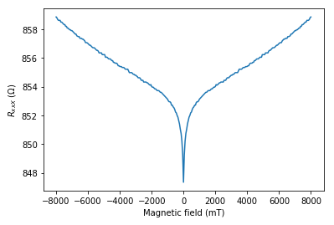
Magnetotransport measurement
Clasically:
$$R_{xx}∝{\left(μB\right)}^{2}$$
Signature of weak anti-localization
Non-linearity of $ρ_{xy}$
Correction to
classical Resistance
2K
1
0
Non-linear
2K
-1
Similar conclusions : Liu, M. et al. Phys. Rev. Lett. 108 (2012), 036805
Notes:
As you can see on this magnetotransport measurement, a strong negative cusp is present.
This negative cusp can generally be associated with weak anti-localization effects in topological material.
In absence of a magnetic field, the wavefunctions of back-scattered electrons interfere destructively with one another which reduces back-scattering and increase the conductivity.
Similarly to weak localisation, the introduction of a magnetic field adds a supplementary phase which thus destroy this effect and increase resistivity.
By looking now at the transverse Hall resistivity, its profile is not purely linear.
This can be associated to different causes, among them being the presence of magnetic scattering which breaks the time reversal symmetry.
To investigate this further, we look at the evolution of the longitudinal resistivity with temperature.

Slide 9
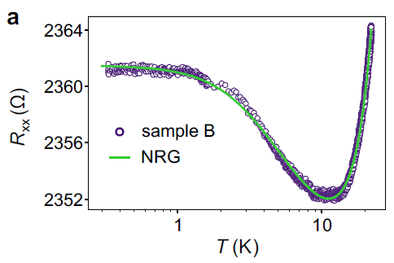
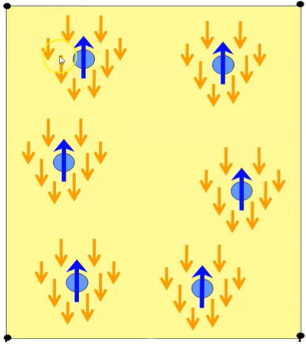
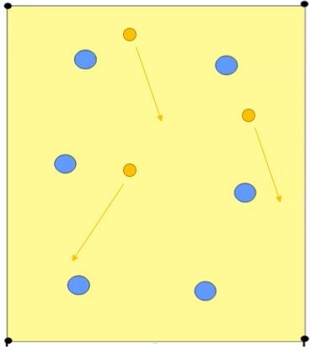
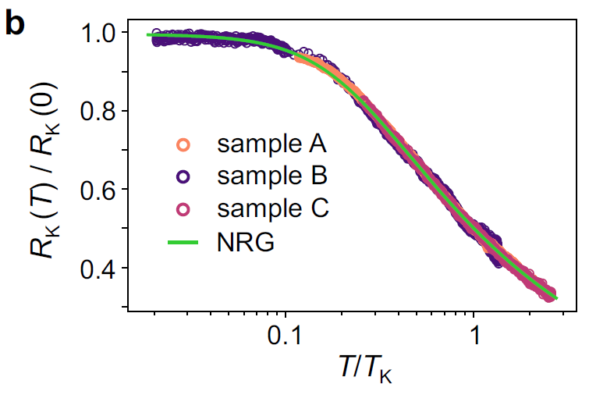
Magnetotransport measurement
R_{xx}(T) presents a minimum !
Signature of weak anti-localization
Non-linearity of $ρ_{xy}$
Minimum in R_{xx}(T), suggests a Kondo effect
Very good fit by numerical renormalization group calculations (NRG)
Strong evidence for magnetic scattering
T>T_{K}
Universal curve
T<T_{K}
T_{K} = 16K
NRG : $R_{K}\left(\frac{T}{T_{K}}\right)=R_{K}\left(0\right)\left(\frac{{T_{K}^{′}}^{2}}{T^{2}+{T_{K}^{′}}^{2}}\right)$
${T_{K}^{′}}^{2}={T_{K}\left(2^{1/s}−1\right)}^{1/2}$
Notes:
The longitudinal resistance vs temperature presents a minimum at a finite temperature.
This behaviour is generally associated with a Kondo effect.
The scattering of electrons increases at lower temperature as their coherence length increases.
The phenomenon plateaus as the magnetic scatterers are progressively screened by electrons when the temperature tends to 0.
Indeed, when the normalised resistance is plotted against the normalised temperature, all the results from different samples span along a single line.

Slide 10
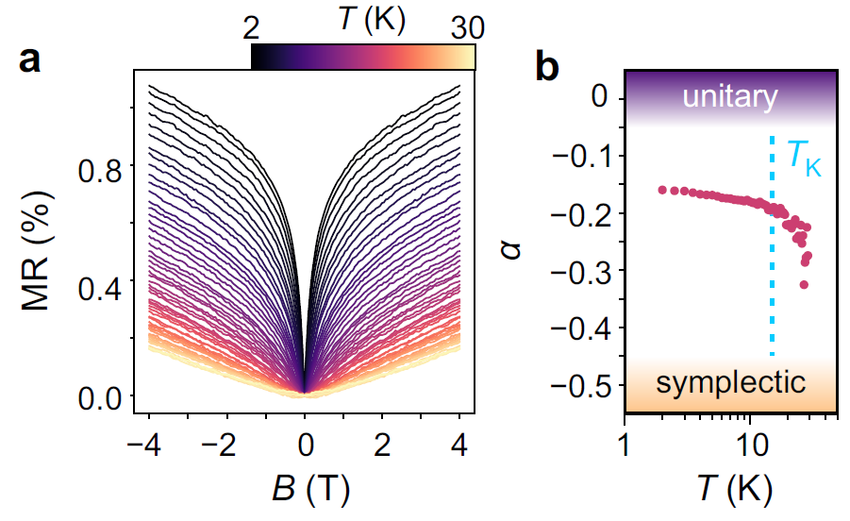
Magnetotransport measurement
HLN model : $Δσ=α\frac{e^{2}}{h}[\left(0.5+\frac{B_{φ}}{B}\right)−\ln\left(\frac{B_{φ}}{B}\right)]$
Temperature dependent parameter
Three boundary cases :
$α=1$ ➔ Scattering on magnetic imputities & SO interaction is negligible
$α=0$ ➔ Scattering on magnetic imputities is dominant
$α=−0.5$➔ SO interaction is dominant
$α\left(T→0\right)=−0,15$
Notes:
As you can see on the top left right figure, the anomalous component of the magnetoresistance vanishes with increasing temperature. This is coherent with the presence of magnetic scatterers whose effect is decreased at higher temperature as the coherence length of electrons is also decreased.
If one uses the HLN equations to fit the temperature dependent behaviour, three limit cases can be identified.
For alpha = 1, both magnetic scatterers and spin-orbit coupling are negligible and thus weak localization is dominant.
For alpha = 0, the magnetic scatterers induce random spin switching during collisions along the path and thus destroy the weak localization effect.
Finally, for alpha = -0,5, the ensemble is said to be symplectic. Weak anti-localization happens. This situation happens when magnetic scatterers are negligible and the spin-orbit interaction is dominant.
If one extracts the alpha pre-factor alpha based on the HLN equations, it plateaus at -0,15 towards 0K which points to a weak anti-localization effects with a strong participation of magnetic scatterers. Over the Kondo temperature, this coefficient goes to -0,5 which is coherent as over the Kondo temperature, the Kondo effect decreases and thus the effect of magnetic scatterers on the electrons along the closed path.

Slide 11
There are magnetic scatterers in the superlattice
Fabrication process and crystal characterisation exclude doping
Where do these magnetic scatterers come from ?
Notes:
As we have just established, we see in the magnetotransport measurement different clues pointing to a strong effects of magnetic scatterers in the heterostructure. The fabrication methods and the following characterisation exclude the presence of doping atoms in the crystal.
Thus we are left with the question, where do these magnetic scatterers come from ?

Slide 12
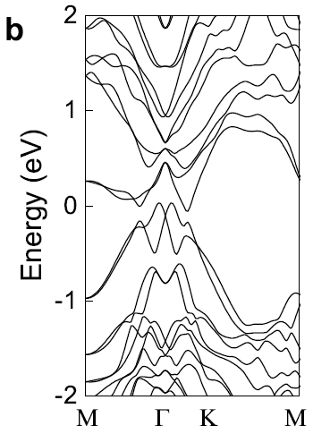
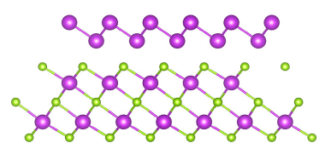
DFT simulations : Bi₄Se₃
Bi vacancy
Vacancy and antisite defects in Bi₂Se₃ were investigated
None of them had a net magnetic moment
Notes:
To answer this question, we use DFT to simulate 1 Bi2 layer along with 2 Bi2Se3 layers. By removing a Bi atom we noticed thayt the formation energy of this defect is rather low, from 0,5 to 1eV. In addition, as it can be seen in the band structures, this vacancy creates an asymmetry in the spin up and down located on the 4p band of the Se atom. We associate the magnetic scattering effect seen in the magnetotransport measurement to these localised magnetic states.

Slide 13
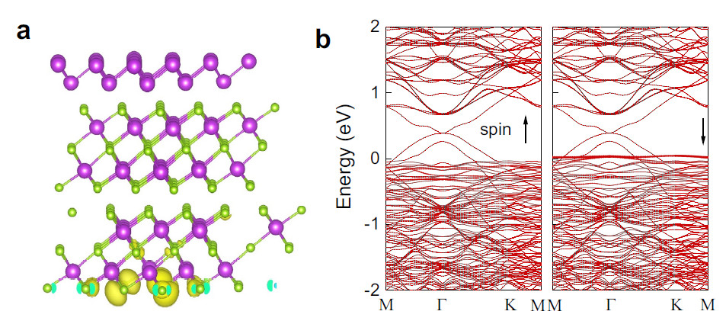
DFT simulations : superlattice
Bi vacancy
Bi vacancies have a low formation energy ($≈$0.5eV)
Localized spin-down state appear from the 4p band in Se
Bi vacancies act as intrinsic magnetic scatterers
Notes:
To answer this question, we use DFT to simulate 1 Bi2 layer along with 2 Bi2Se3 layers. By removing a Bi atom we noticed thayt the formation energy of this defect is rather low, from 0,5 to 1eV. In addition, as it can be seen in the band structures, this vacancy creates an asymmetry in the spin up and down located on the 4p band of the Se atom. We associate the magnetic scattering effect seen in the magnetotransport measurement to these localised magnetic states.

Slide 14
DFT simulations : Bi₄Se₃
Bi vacancy
Vacancy and antisite defects in Bi₂Se₃ were investigated
None of them had a net magnetic moment
Charge transfer from Bi₂ to Bi₂Se₃ prevents the apparition of magnetised states
Notes:
To answer this question, we use DFT to simulate 1 Bi2 layer along with 2 Bi2Se3 layers. By removing a Bi atom we noticed thayt the formation energy of this defect is rather low, from 0,5 to 1eV. In addition, as it can be seen in the band structures, this vacancy creates an asymmetry in the spin up and down located on the 4p band of the Se atom. We associate the magnetic scattering effect seen in the magnetotransport measurement to these localised magnetic states.

Slide 15
_{Conclusion}
High quality (Bi₂)₅(Bi₂Se₃)₇ layers were grown by PA-MBE
Magnetic scattering was observed in the magnetotransport measurements
We tentatively attribute these effects to Bi vacancies which create localised magnetised states around them

Slide 16
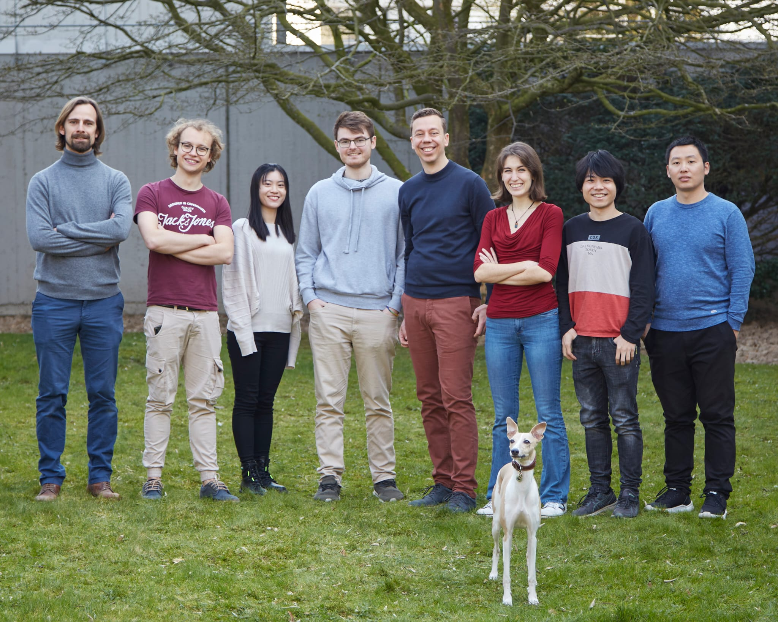
Pascal Gehring
MBE
Magnetotransport
Clément Merckling
Stefan De Gendt
Michel Houssa
Ruishen Meng
Bart Raes
DFT simulations
(PhD and )Post-doc positions available
www.gehring-lab.com
pascal.gehring@uclouvain.be
Notes:
Hello everyone, thanks for the introduction
Today I have the pleasure to present you the recent results that my research group at UCLouvain has obtained in close collaboration with IMEC and the KULeuven.
We investigate magnetotransport in MBE grown heterostructure of Bi2Se3 and conclude to the likely existence of intrinsic magnetic scatterers in these heterostructures.

Slide 17
Thank you for listening !

Slide 18
Additional slides

Slide 19
Fabrication process
Plasma-assisted molecular beam epitaxy
Bi is a standard effusion cell
Se atoms are extracted from H2Se using a RF plasma
(Outside of deposition chamber)
Al₂O₃ or CaF₂
1) PA-MBE growth of Bi_{x}Se_{y}
2) Optional: in-situ growth of capping layer (evaporation)
3) Lithography + dry etching
4) Lithography + metallisation
Top view
Side view
Saphhire

Slide 20
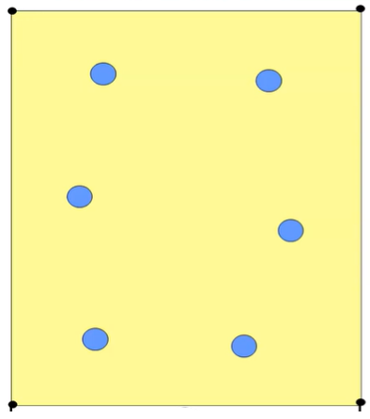
First principle : details

Slide 21
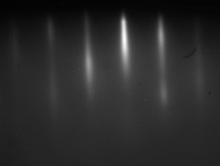
Extra data : crystal quality

Slide 22
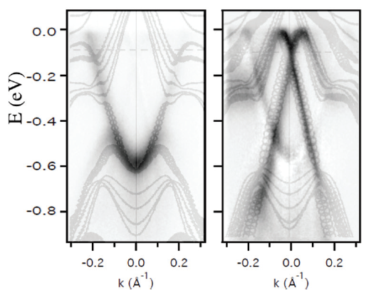
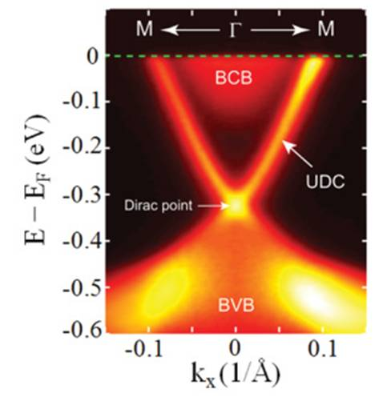
ARPES from reference
ARPES
Termination :
Bi₂Se₃ Bi₂
Gibson, Q. D. et al. Phys. Rev. B 88, 081108 (2013).
Jozwiak, C. et al. Nature Phys 9, (2013) 293–298

Slide 23
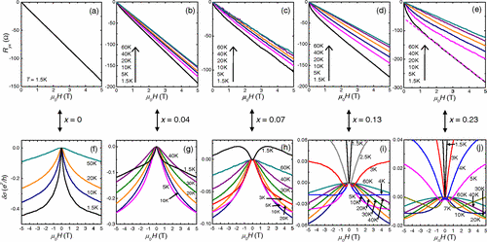
Transition from WL to WAL in a TI
Asymmetry
Liu, M. et al. Phys. Rev. Lett. 108 (2012), 036805

